Slide 1
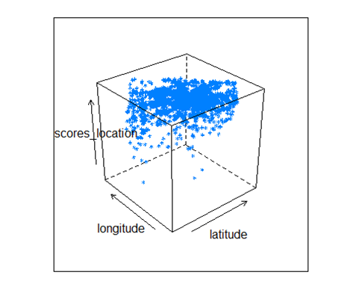
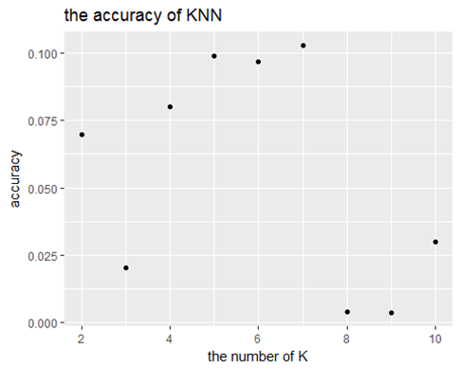
How to decide location factor
variables related with location: neighbourhood categorical (ex Dupont Circle), longitude, latitude, review_scores_location
Neighbourhood categorical is filled by the host, random description
review_scores_location should be used to represent location
Use KNN to predict review_scores_location by longitude and latitude.

Slide 2
Variables
All Airbnb listings in Washington, DC (7788 observations; 95 variables)
Dropped nonimal columns that are irrelevant to pricing model (e.g. listing_url, thumbnail_url)
Price is related with objective factors and subjective factors
objective factors: location and size
subjective factors: how is the host
This model can provide a reasonable price for renters
Source: http://insideairbnb.com/get-the-data.html

